Slide 1
Medical Imaging Group Studies: Data Analysis and Image Reconstruction
Jack Joynson and Ziyue Wang

Slide 2
Introduction
The aim of this subgroup is to generate software to reconstruct images from Compton camera data.
The image should show where the gamma ray source(s) are located.
The code has been written in C++ using Object Orientated techniques.
Notes:
whether this is simulated or experimental data.
Exception is MATLAB

Slide 3
Overview
Coincidence Finder
User input
Data calibration
Filtering
Image Reconstructor
Cone generation
Conic sections
Pixelation
Plotter
Data plotting

Slide 4
Coincidence Checker – Calibrating Data
The digitisers used by the experimental team output the timestamp and an uncalibrated energy of each event.
The Coincidence Checker program reads each uncalibrated energy and applies a calibration.
The timestamp can also be shifted.
Notes:
The timestamp in experimental data is the 100s of picoseconds since start?
File per detector
detector specific calibration – calculated using the histogram program.

Slide 5

Coincidence Checker – Filtering Data
The calibrated energy is checked against the user defined limits.
Valid events are stored in an ‘$EventEntry$’ object.
Lists of ‘$EventEntry$’ objects are created for each detector.
Notes:
Greater than.. Less than..
Explain what the evententry stores?

Slide 6
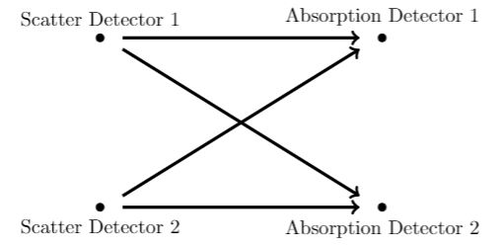
Coincidence Checker – Finding Coincidences
The events from scattering detector lists are then checked against events from absorber detector lists.
Notes:
Each against each in pairs

Slide 7
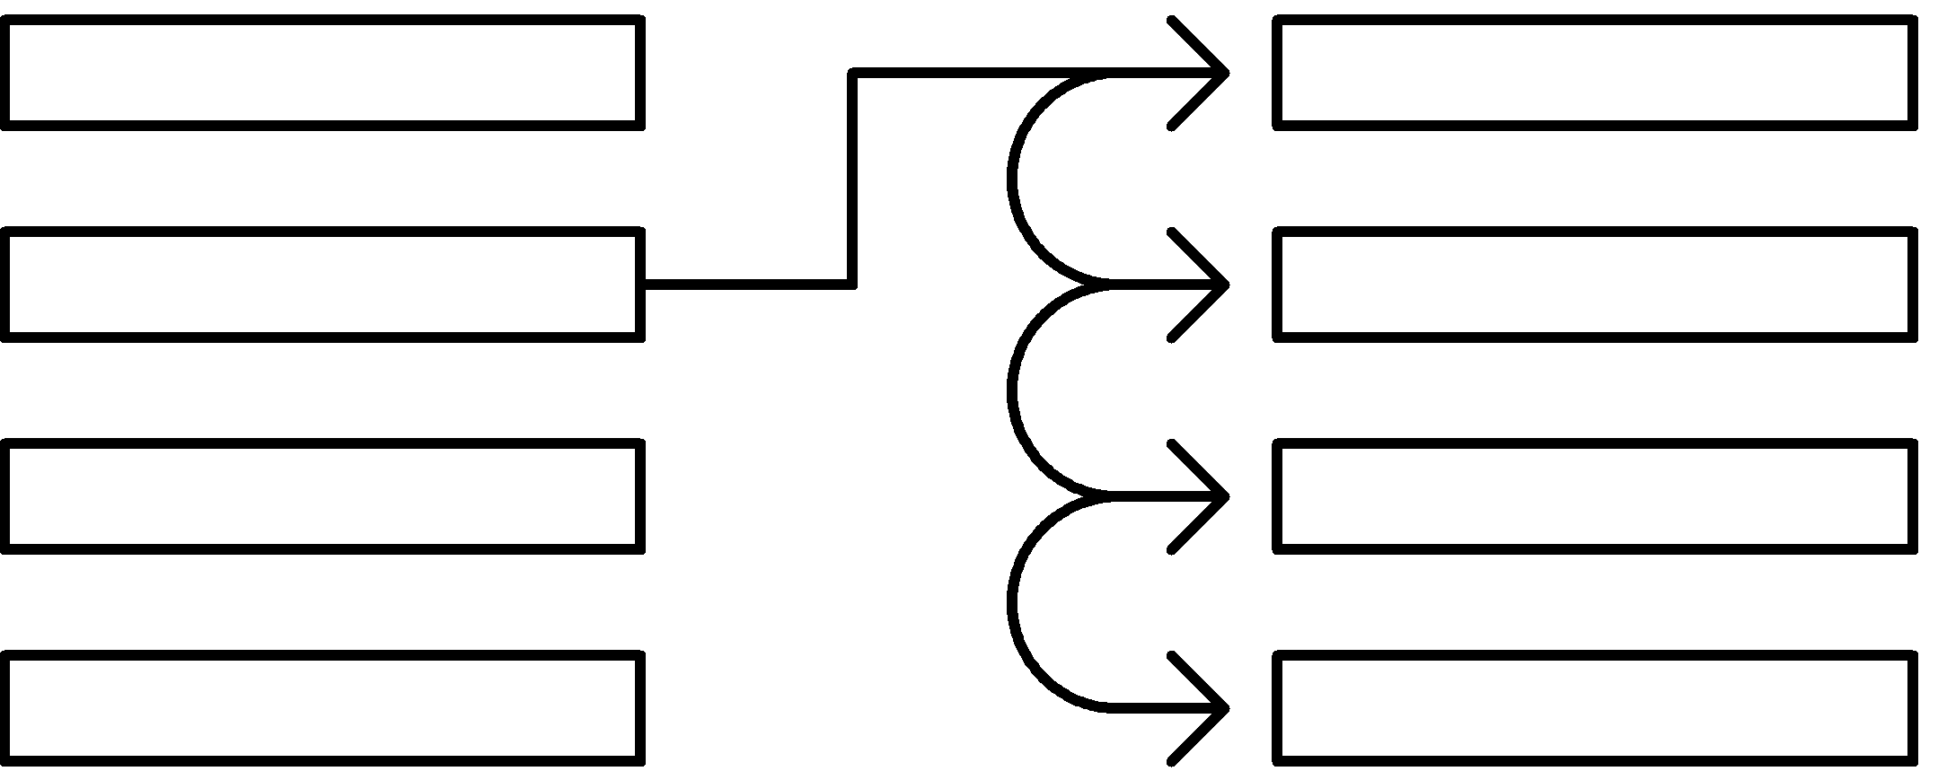
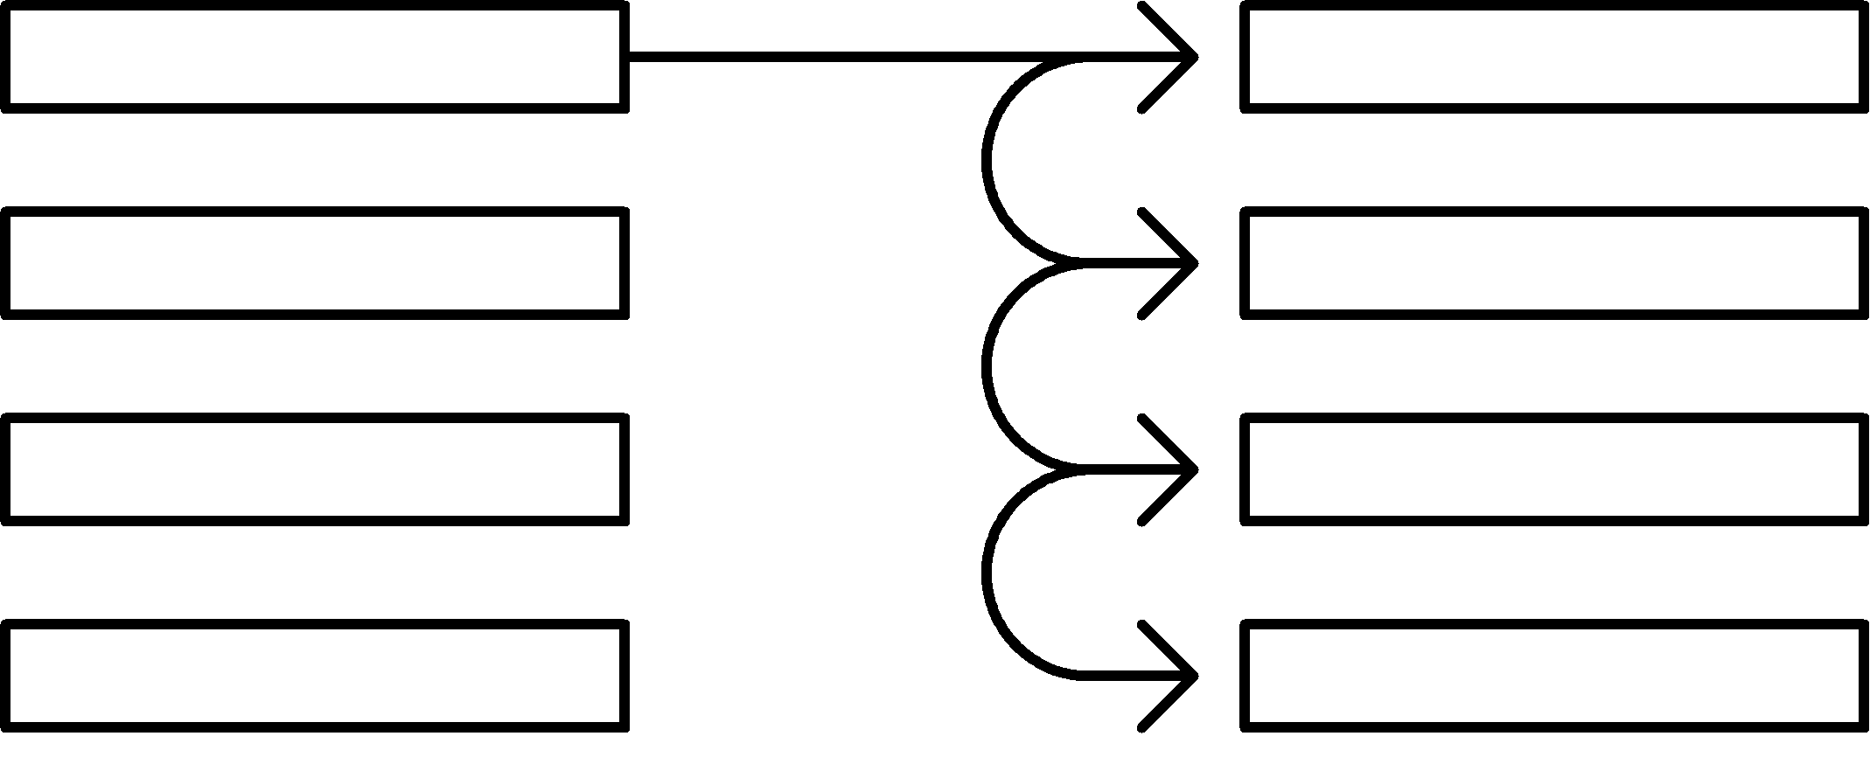
Coincidence Checker – Finding Coincidences
A coincidence is found when the timestamp of two events are within tolerance of each other.
Scatter events list
Absorber events list
Notes:
First scatter event against first absorber then iterates through absorber until finds or reaches end. Then moves on
When finds one The timestamp, energy and detector number from both events is then output to a file.

Slide 8

Image Reconstruction - Reading Data Files
Each line of data corresponds to a coincidence.
The detector numbers are used to get the geometries from the ‘$DetectorType$’ list which is populated by the user inputs.
The energies are used to work out the scattering angle.
Notes:
The image reconstruction software has to work with simulated or experimental data processed with the ‘Coincidence checker’.
Experimental has headers which are ignored by program.
Energy provided in KeV

Slide 9

Cone Generation
A $Cone$ object is produced for each coincidence.
The object defines the properties of the cone including the half angle and the image plane intersection.
Notes:
By the conegenerator class.
Diagram?
Explain how Compton formula used?
Trig?

Slide 10
Conical back-projection
Generated by the “cone generator” class
Fig. Back projection of a
Compton scattering event,
Leading to a cone projection
with the cone having scattering
angle equal to the Compton
scatter. [1]

Slide 11
Detector Setup
Scattering detector
Absorbing detector
x
dx
dz
z
Fig. Bird’s eye view of setup

Slide 12
Detector Setup
Scattering detector
Absorbing detector
x
dx
dz
Scattering rays
z
Fig. Bird’s eye view of setup

Slide 13
Ellipse Generation
This process is done by the “cone to
ellipse” generation class.
Fig. Conic sections of the
Back-projected cones. [2]
Notes:
By the conegenerator class.

Slide 14
Ellipse basics
Semi-minor axis
R_{max}
Focus
R_{min}
Semi-major axis
Fig. Annotated ellipse explaining basic parameters of an ellipse.

Slide 15
Ellipse projection onto plane
+y
Fig. Projection of cone plane intersection results in ellipse. Stacked ellipses result in good images.
source
-x
+x
-y

Slide 16
Matrix Generation
Need to know where the most ellipse intersections occur.
The program ‘draws’ each ellipse onto a matrix of pixels.
The count at each of the pixels is incremented whenever an ellipse is drawn onto it.
Intersections will naturally have a higher count than the surrounding pixels.
Notes:
When saying ‘draws’ its actually just calculates the X and Y positions of the ellipse using polar coordinates and incrementing the angle.

Slide 17
Matrix plotting
C# MATLAB
Surf plot – I’ll add to this tomorrow once I get the files off campus
Problem that a high density pixelation means ellipses within a small error of each other do not stack.

Slide 18
Results
Plots
Accuracy and Precision

Slide 19
Fig. Simulation results from NaI. Midpoint is defined as 500,500 (pixels). 1 pixel = 1mm. Brightest spot (labelled) indicates
location of source. Source should be at x = 500, y = 530. 1.8cm/18 pixels off target.

Slide 20
Uncertainties
Energy – Explain filtering helps. We going to add sum check?
Random events – Timestamp shift helps +^^
Finite detector size
Geometry measurement error.
Geometry effects image quality – how elongated/overlap point etc.

Slide 21
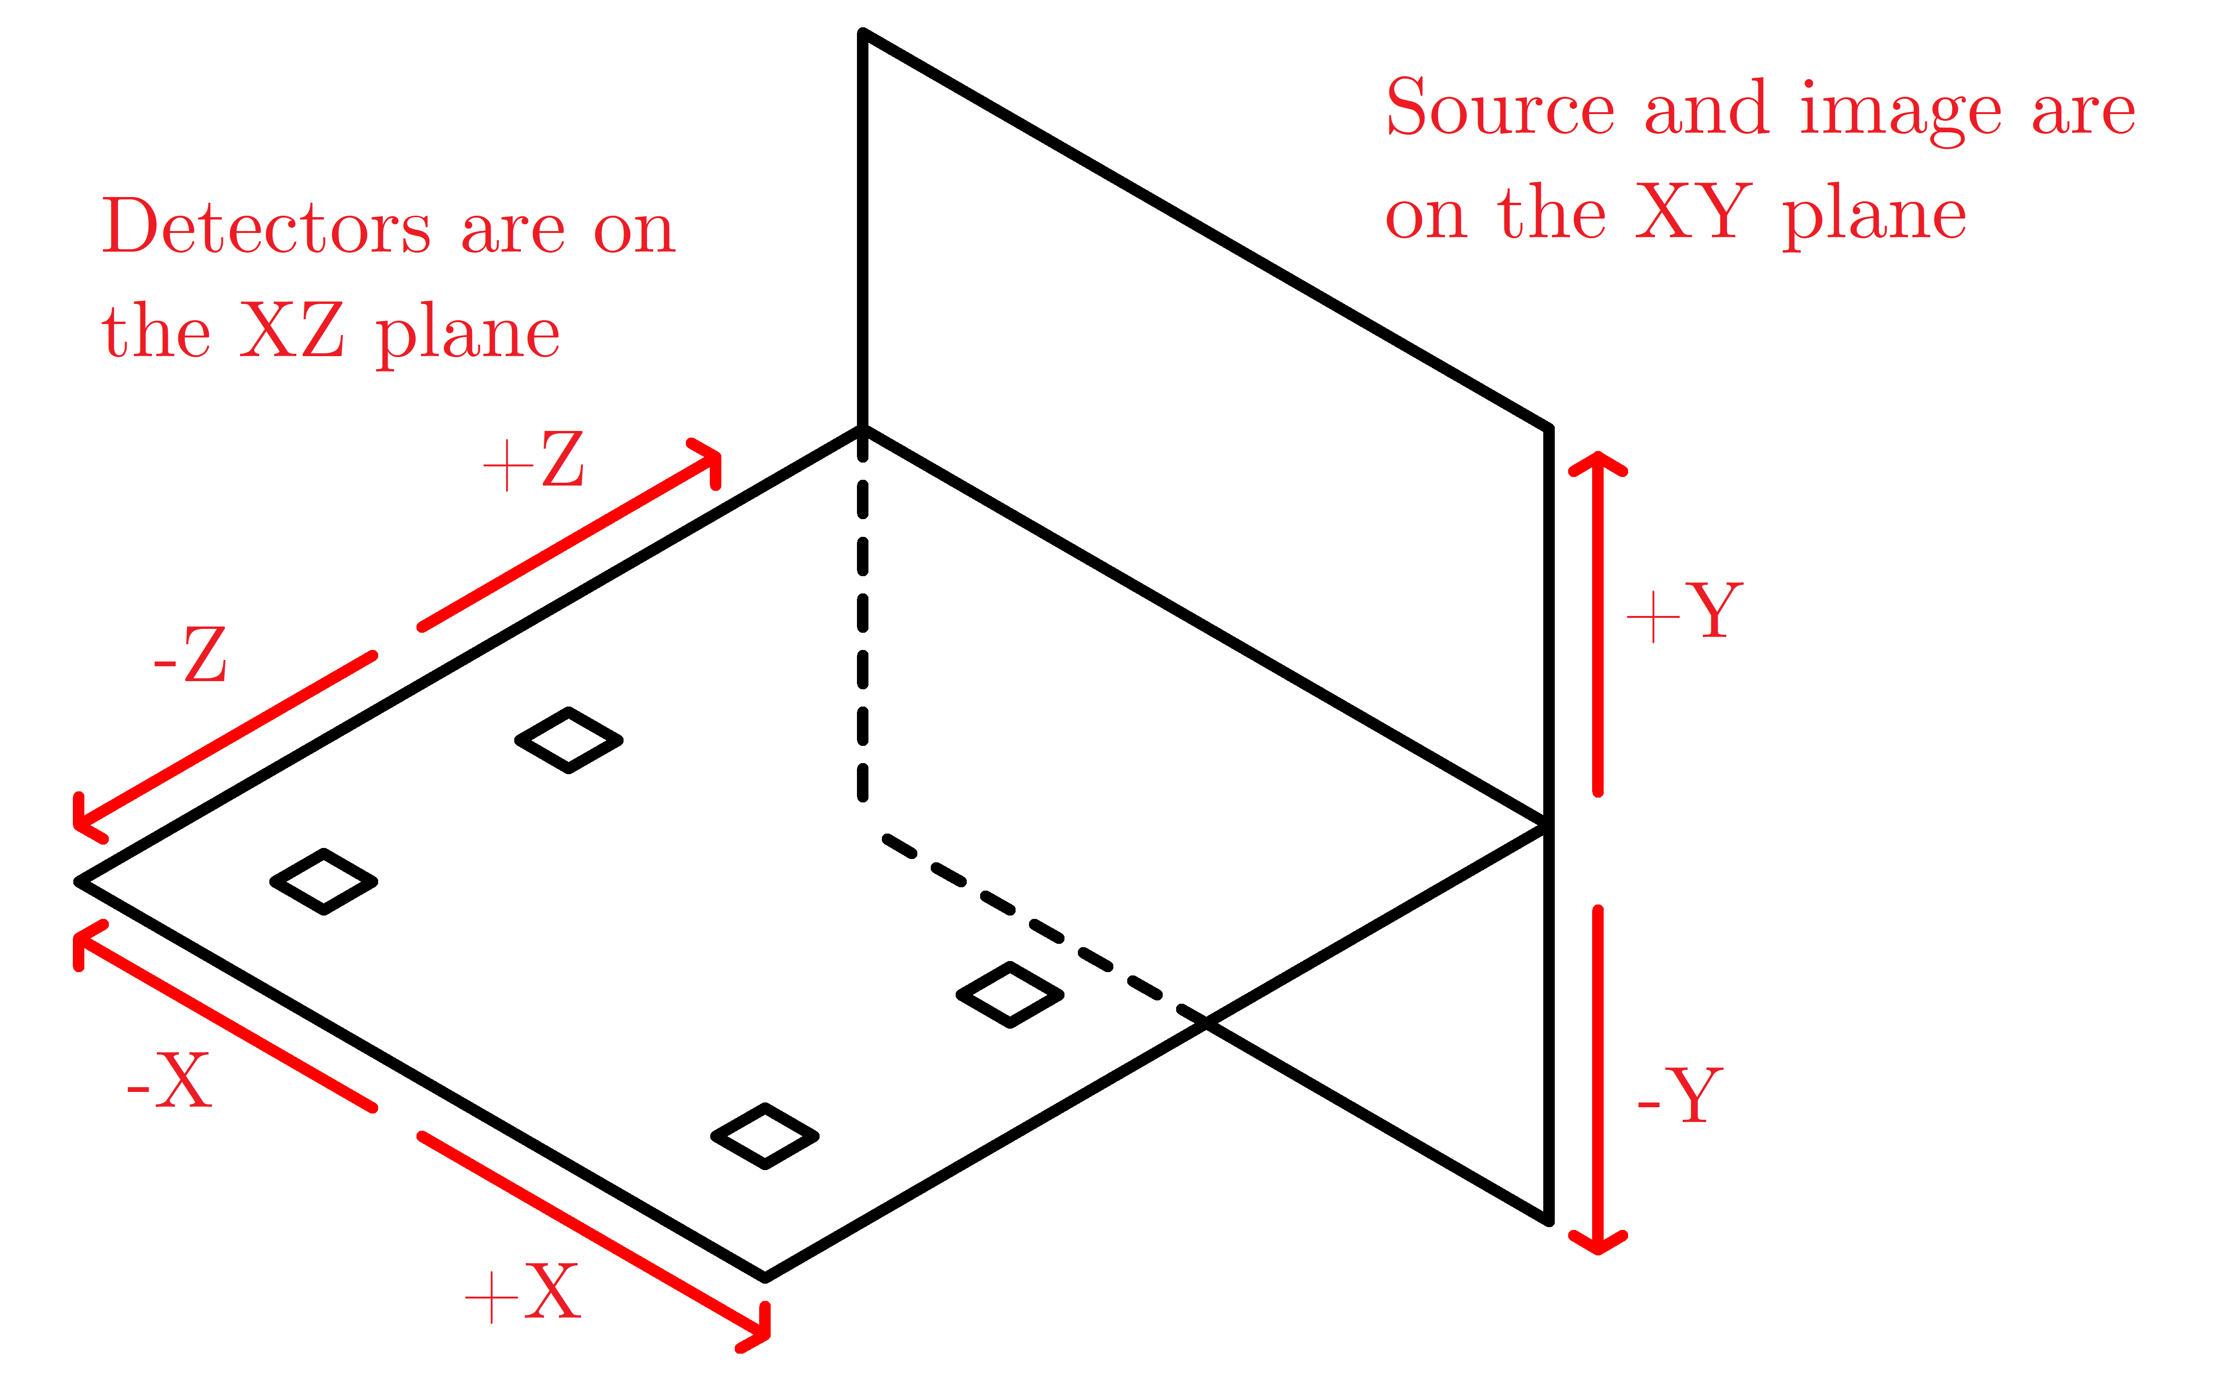
Limitations
Detectors are required to be on a single plane.
Notes:
A Compton camera being using for medical purposes would likely require the detectors to be able to move in all 3 dimensions. This complicates the mathematics blah blah.
May also have to iterate through different height slices? As in how do you work out the source distance.

Slide 22
Limitations
More detectors should produce a better image but takes a long time to process.
Need enough events so that the random events are smeared out by the average.
Shifting the geometry of detectors due to geometric centre being different from mean scattering position.
Notes:
A Compton camera being using for medical purposes would likely require the detectors to be able to move in all 3 dimensions. This complicates the mathematics blah blah.
May also have to iterate through different height slices? As in how do you work out the source distance.

Slide 23
References
3D Image Reconstruction from Compton camera data - INSPIRE-HEP. 2018. 3D Image Reconstruction from Compton camera data - INSPIRE-HEP. [ONLINE] Available at: http://inspirehep.net/record/1446785. [Accessed 11 March 2018].
Conic section - Wikipedia. 2018. Conic section - Wikipedia. [ONLINE] Available at: https://en.wikipedia.org/wiki/Conic_section. [Accessed 11 March 2018].

